Slide 1
Welcome
Congregational Meeting in Response to General Conference 2024
Richmond First United Methodist Church
September 14, 2024

Slide 2
Today’s Agenda:

Slide 3
Today’s Agenda:

Slide 4
Today’s Agenda:
Bible study / Worship

Slide 5
Today’s Agenda:
Bible study / Worship
Presentation of Survey Results

Slide 6
Today’s Agenda:
Bible study / Worship
Presentation of Survey Results
Discussion: Christian Witness in Diverse Spaces

Slide 7
Today’s Agenda:
Bible study / Worship
Presentation of Survey Results
Discussion: Christian Witness in Diverse Spaces
Closing Worship

Slide 8
Ezra 3:10-13

Slide 9
¹⁰ When the builders laid the foundation of the temple of the Lord, the priests in their vestments and with trumpets, and the Levites (the sons of Asaph) with cymbals, took their places to praise the Lord, as prescribed by David king of Israel. ¹¹ With praise and thanksgiving they sang to the Lord:
“He is good; his love toward Israel endures forever.”

Slide 10
And all the people gave a great shout of praise to the Lord, because the foundation of the house of the Lord was laid. ¹² But many of the older priests and Levites and family heads, who had seen the former temple, wept aloud when they saw the foundation of this temple being laid, while many others shouted for joy. ¹³ No one could distinguish the sound of the shouts of joy from the sound of weeping, because the people made so much noise. And the sound was heard far away.

Slide 11
The best of time, the worst of times…

Slide 12
“No one could distinguish the sound of the shouts of joy from the sound of weeping…”

Slide 13
Prayer

Slide 14
Congregational Survey

Slide 15
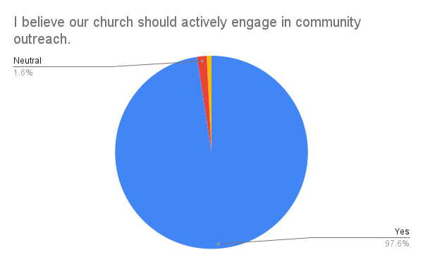

Slide 16
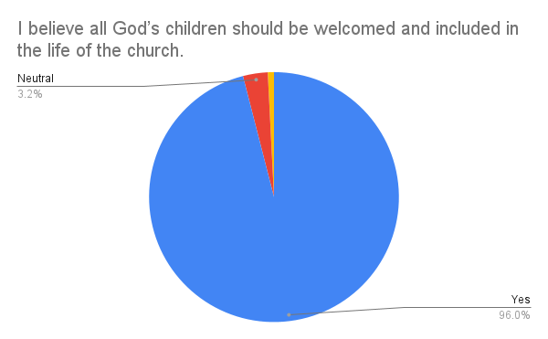

Slide 17
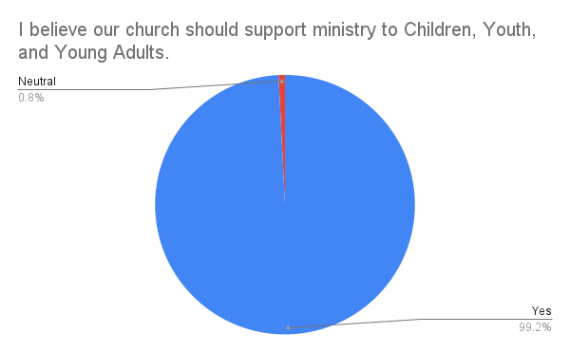

Slide 18
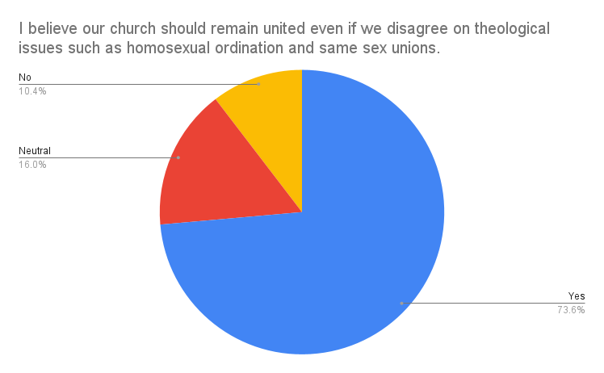

Slide 19
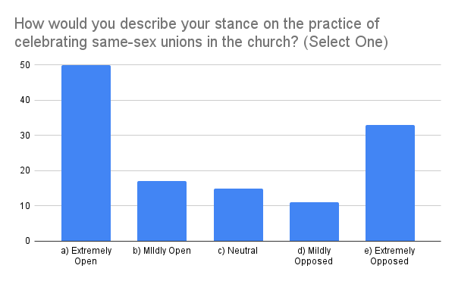

Slide 20
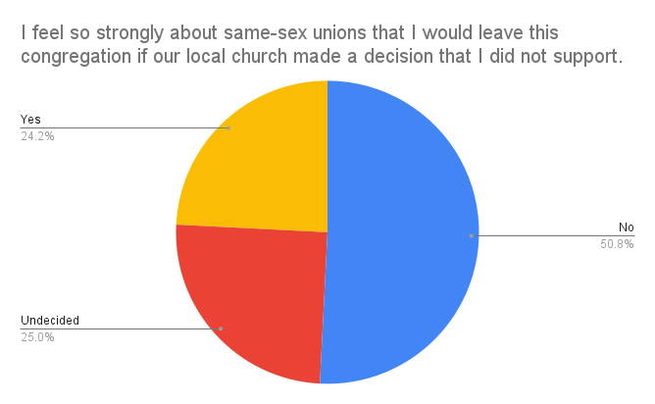

Slide 21
Among those who consider themselves “open”
14 yes 10 undecided
Among those who consider themselves “opposed”
16 yes 20 undecided

Slide 22
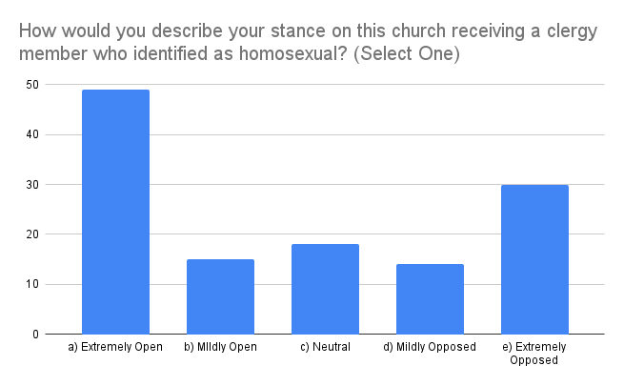

Slide 23
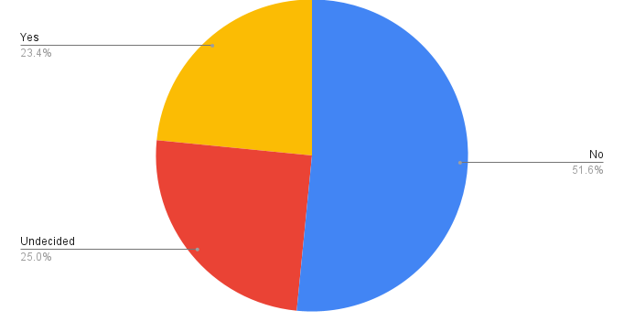
I feel so strongly about being led by homosexual clergy that I would leave this congregation if our local church made a decision that I did not support.

Slide 24
I feel so strongly about being led by homosexual clergy that I would leave this congregation if our local church made a decision that I did not support.
Among those who consider themselves “open”
5 yes 9 undecided
Among those who consider themselves “opposed”
24 yes 15 undecided

Slide 25
What promises can we make to each other that will help us thrive together in this diverse space?

Slide 26
Break

Slide 27
What you would like to say a fellow church member who decides they must leave our church in order to follow their own conscience?

Slide 28
Acts 20

Slide 29
Celebrating Our Past Together

Slide 30
Celebrating Our Past Together
“I served the Lord with great humility and with tears and in the midst of severe testing…”

Slide 31
Celebrating Future Faithfulness

Slide 32
Celebrating Future Faithfulness
“…not knowing what will happen to me… my only aim is to finish the race and complete the task the Lord Jesus has given me…”

Slide 33
Our Prayer for One Another

Slide 34
Our Prayer for One Another
“Now I commit you to God and to the word of his grace, which can build you up and give you an inheritance among all those who are sanctified.”

Slide 35
A Moment Shared

Slide 36
A Moment Shared
When Paul had finished speaking, he knelt down with all of them and prayed. They all wept as they embraced and kissed him. What grieved him most was his statement that they would never see his face again. Then they accompanied him to the ship.

Slide 37
The Story Continues

Slide 38
The Story Continues
“After we had torn ourselves away from them…”

Slide 39
oops

Slide 40
oops
(awkward!)

Slide 41
Holy Communion

Slide 42
Blest Be the Tie That Binds

Slide 43
Blest be the tie that binds
Our hearts in Christian love;
The fellowship of kindred minds
Is like to that above.

Slide 44
Before our Father’s throne
We pour our ardent prayers;
Our fears our hopes our aims are one,
Our comforts and our cares.

Slide 45
We share each other’s woes,
Our mutual burdens bear;
And often for each other flows
A sympathizing tear

Slide 46
When we asunder part,
It gives us inward pain;
But we will still be joined in heart,
And hope to meet again.

